Slide 1
Major Project – MCA491P
Enhanced LongRange Location Tracking and Fall Detection System
1RV23MC039
RAJESHA C U
Under the Guidance
Of
Dr. Deepika K Associate Professor Department of MCA

Slide 2
Agenda
Changes suggested in Phase I and Incorporation
Tools and Technologies Used
Hardware and Software Requirements
Functional Requirements- Module specification
Non-functional Requirements
Design Constraints
System design- Architecture design
Detailed Design- Class Diagram, Use Case diagram, sequence diagram, activity diagram and DFD (level-0 to level-2)
Work progress
References

Slide 3
Project based Learning
Sl No | Particulars / Details | Details of Implementation
1 | Course on “React.js” | It helps to design the frontend of the web interface
2 | Course on “Node.js” | It helps to build the backend of the web application

Slide 4
Design Methodology
Hardware and Software Requirements
Sl No | Components | Purpose
1 | ESP32 | Collects data from sensors; sends via MQTT
2 | LoRa Module | Long-range wireless communication
3 | BME280 | Measures temp/humidity/pressure
4 | GPS Module | Tracks location
Sl No | Components | Purpose
1 | Next.js (Frontend) | Web dashboard
2 | MQTT Broker (Mosquitto) | Lightweight messaging protocol
3 | PostgreSQL | Database to store sensor readings & logic
4 | Node.js | Backend for sensor data
5 | MicroPython / Arduino IDE | Programming ESP32 sensor logic

Slide 5
Design Methodology
ESP32 + LoRa enables low-power, long-range wireless communication for field-deployed sensor nodes.
MQTT ensures efficient, real-time data transfer between devices and the backend with minimal bandwidth.
PostgreSQL provides reliable storage.
Next.js delivers a fast, modern web dashboard with server-side rendering and seamless user experience.
Python allows flexible backend scripting for data processing, alert logic, and easy future enhancements.
Leaflet.js integrates interactive maps for live location tracking and visualization of all field nodes.
Arduino IDE simplifies firmware development and rapid prototyping for ESP32-based sensor nodes.

Slide 6
Functional Requirements Specification
Module Name: Location Tracking
Purpose: To update and display user/node GPS location.
Input: GPS coordinates from FieldNode device.
Function: Receives, stores, and maps location data.
Output: User location with timestamp shown on dashboard.
Module Name: Environmental Monitoring
Purpose: To monitor temperature and pressure at each node.
Input: Data from BME280 sensor.
Function: Reads, transmits, and logs environmental data.
Output: Temperature and pressure values with timestamp.
Module Name: Energy Monitoring
Purpose: To track and report device battery status.
Input: Battery voltage/current from FieldNode.
Function: Reads, evaluates, and reports battery level.
Output: Battery percentage and status alert if low.
Module Name: Emergency Alert System
Purpose: To notify admin and users of emergencies.
Input: Emergency trigger from user/device.
Function: Broadcasts alert, logs event, notifies relevant users.
Output: Emergency alert message with user/location info.

Slide 8
Non-Functional Requirements Specification
Sl No | Components | Purpose
1 | Performance | The system must process and display new location and sensor data within 5-10 seconds
2 | Compatibility | The web application must be accessible from all modern browsers and mobile devices
3 | Security | User location and alert data must only be accessible to authorized users and admins

Slide 9
Design Constrains
Sl No | Constraint Type | Description
1 | Technical | LoRa communication range is limited by environmental obstacles and legal frequency restrictions; GPS accuracy may be affected by terrain and weather.
2 | Time | Project must be completed within the academic semester duration (4 months). Integration and testing across hardware and software must fit into limited lab sessions.
3 | Budget | Only low-cost, readily available components (ESP32, LoRa, BME280, GPS) are used; advanced modules or commercial IoT platforms are excluded.
4 | Deployment | System is designed for local or LAN-based deployment; cloud hosting and remote access are not implemented in the initial version.
5 | Environmental | Devices are tested in controlled or semi-controlled environments; harsh outdoor conditions (extreme weather) are not fully addressed in the prototype.

Slide 10
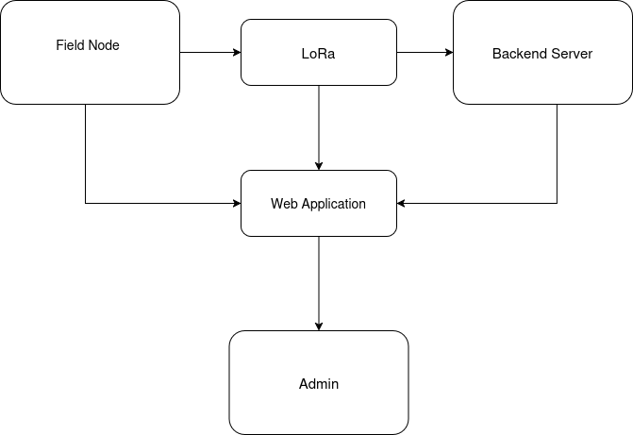
System Design
Block Diagram

Slide 11
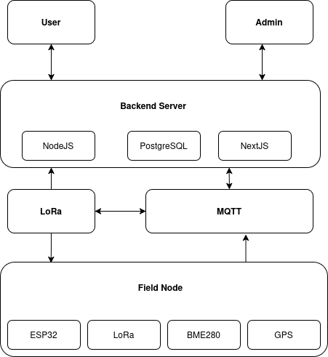
System Design
Architectural diagram

Slide 12
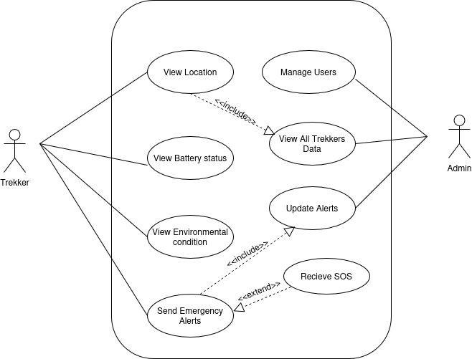
Detailed Design
Use Case diagram

Slide 13
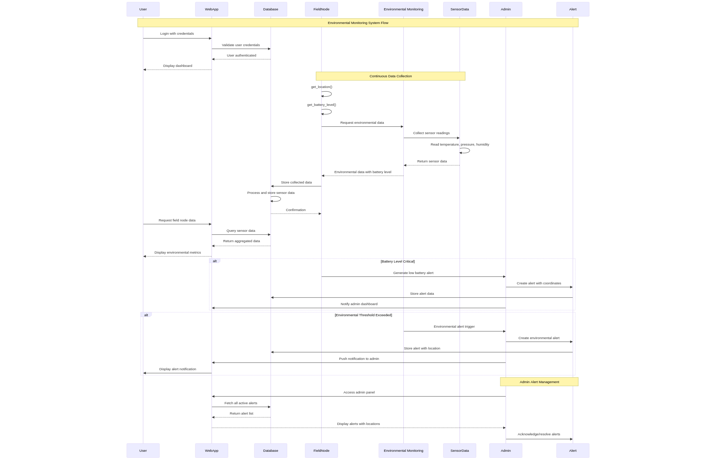
Sequence diagram

Slide 14
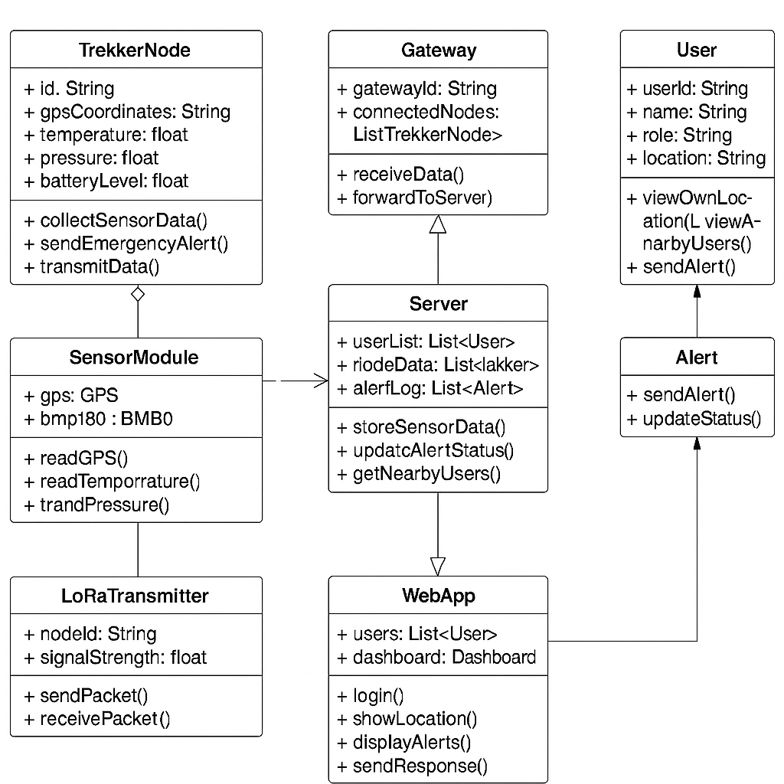
Class Diagram

Slide 15
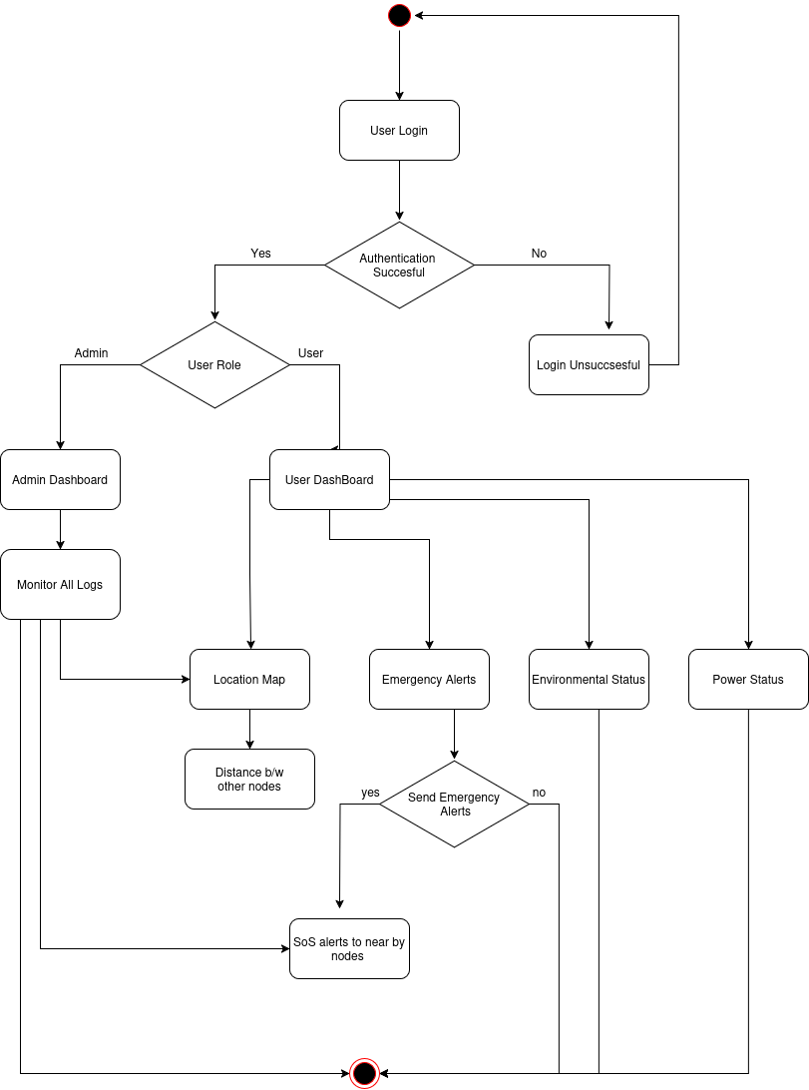
Activity diagram

Slide 16
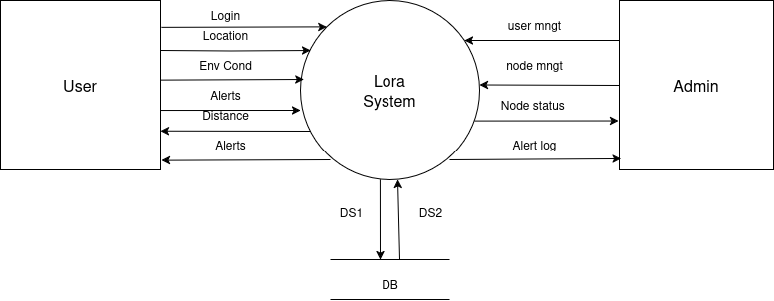
Detailed Design
DFD – Level0
DS1- store data
DS2-retrive data

Slide 17
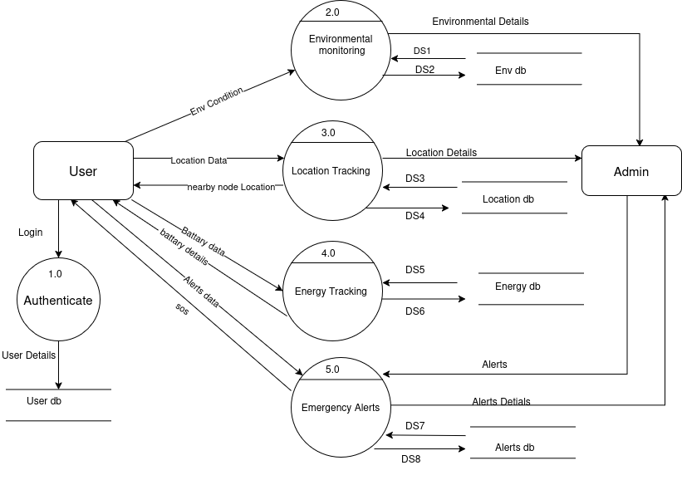
DS1- retrive
DS2-store
DFD – Level 1

Slide 18
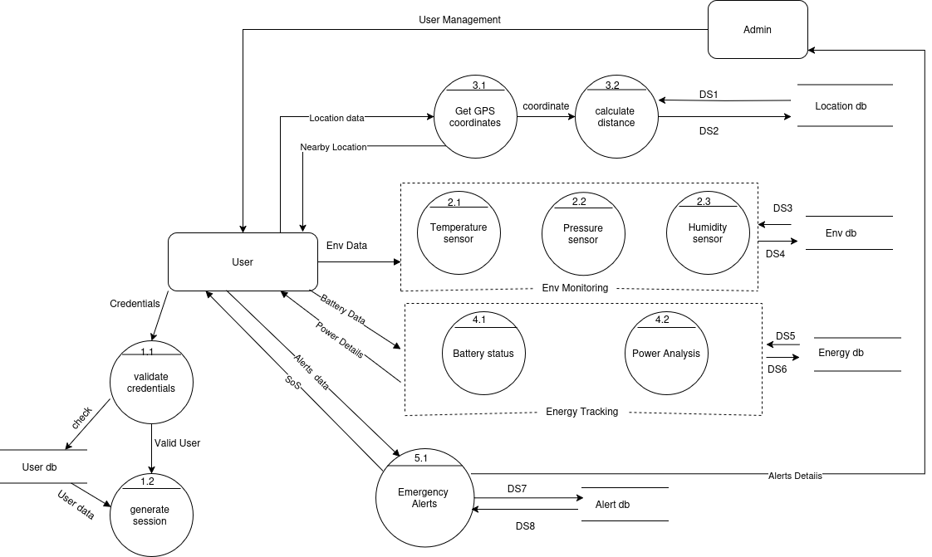
DS1- retrieve data
DS2-Store data
DFD – Level2

Slide 19
Work Progress
Work completed so far:
Design and selection of all hardware components (ESP32, LoRa, GPS, BMP180, Li-ion battery)
Initial web dashboard for location display and alert visualization
Plan for Further Work
Complete physical assembly and wiring of ESP32+LoRa+GPS+BME280 hardware nodes
Integrate battery monitoring and test power management features
Finalize and test real-time data transmission from hardware to backend
Enhance dashboard with data visualization and advanced filtering
Conduct field deployment and calibration of all sensors

Slide 20
References
1] C. Wu et al., "Ultra-Low-Power LoRa Mesh Networks for Wilderness Tracking," IEEE Transactions on Wireless Communications, vol. 24, no. 3, pp. 45-58, 2025.
[2] A. Khan and B. Li, "Adaptive GPS-LoRa Hybrid Positioning for Remote Areas," IEEE Internet of Things Journal, vol. 12, no. 1, pp. 112-125, 2024.
[3] E. Rodriguez et al., "Energy-Efficient Emergency Alert Systems Using ESP32," IEEE Sensors Journal, vol. 23, no. 8, pp. 210-223, 2024.
[4] G. Park and H. Kim, "Decentralized Tracking in Mountainous Terrain: A LoRa Case Study," IEEE Communications Letters, vol. 27, no. 5, pp. 78-91, 2023.
[5] I. Petrov and J. Silva, "Edge Computing for Real-Time Wilderness Safety Monitoring," IEEE Access, vol. 11, pp. 345-360, 2023.
[6] M. Tanaka and S. Chen, "Battery Optimization Techniques for IoT Tracking Devices," IEEE Transactions on Power Electronics, vol. 38, no. 4, pp. 201-215, 2022.
[7] R. Kumar and P. Sharma, "LoRa-Based Communication Challenges in Himalayan Regions," IEEE Wireless Communications Letters, vol. 10, no. 6, pp. 132-145, 2022.
[8] S. Desai and L. Prakash, "Comparative Analysis of Trekker Safety Systems," IEEE Consumer Electronics Magazine, vol. 11, no. 2, pp. 67-79, 2022.
[9] T. Nguyen and V. Patel, "Low-Power Sensor Fusion for Wilderness Tracking," IEEE Sensors Journal, vol. 21, no. 9, pp. 89-102, 2021.
[10] W. Zhang and X. Liu, "IoT Architectures for Remote Area Monitoring," IEEE Internet of Things Journal, vol. 8, no. 5, pp. 156-170, 2021.

